Slide 1
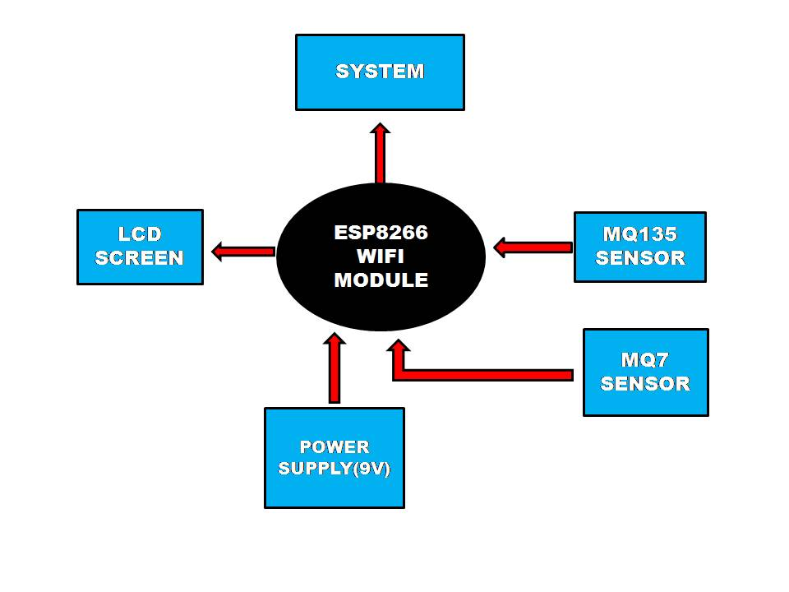
BLOCK DIAGRAM

Slide 2
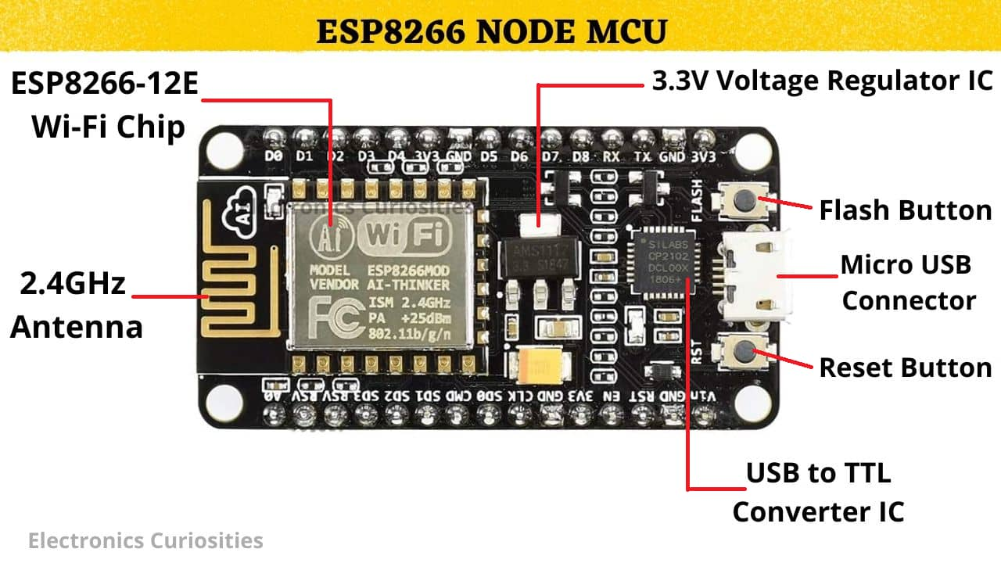
ESP8266 WIFI-MODULE
The ESP8266 is a popular and versatile Wi-Fi module developed by Espressif Systems. It has gained widespread popularity for its low cost, compact size, and ease of use, making it a popular choice for IOT (Internet of Things) and DIY electronics projects.

Slide 3
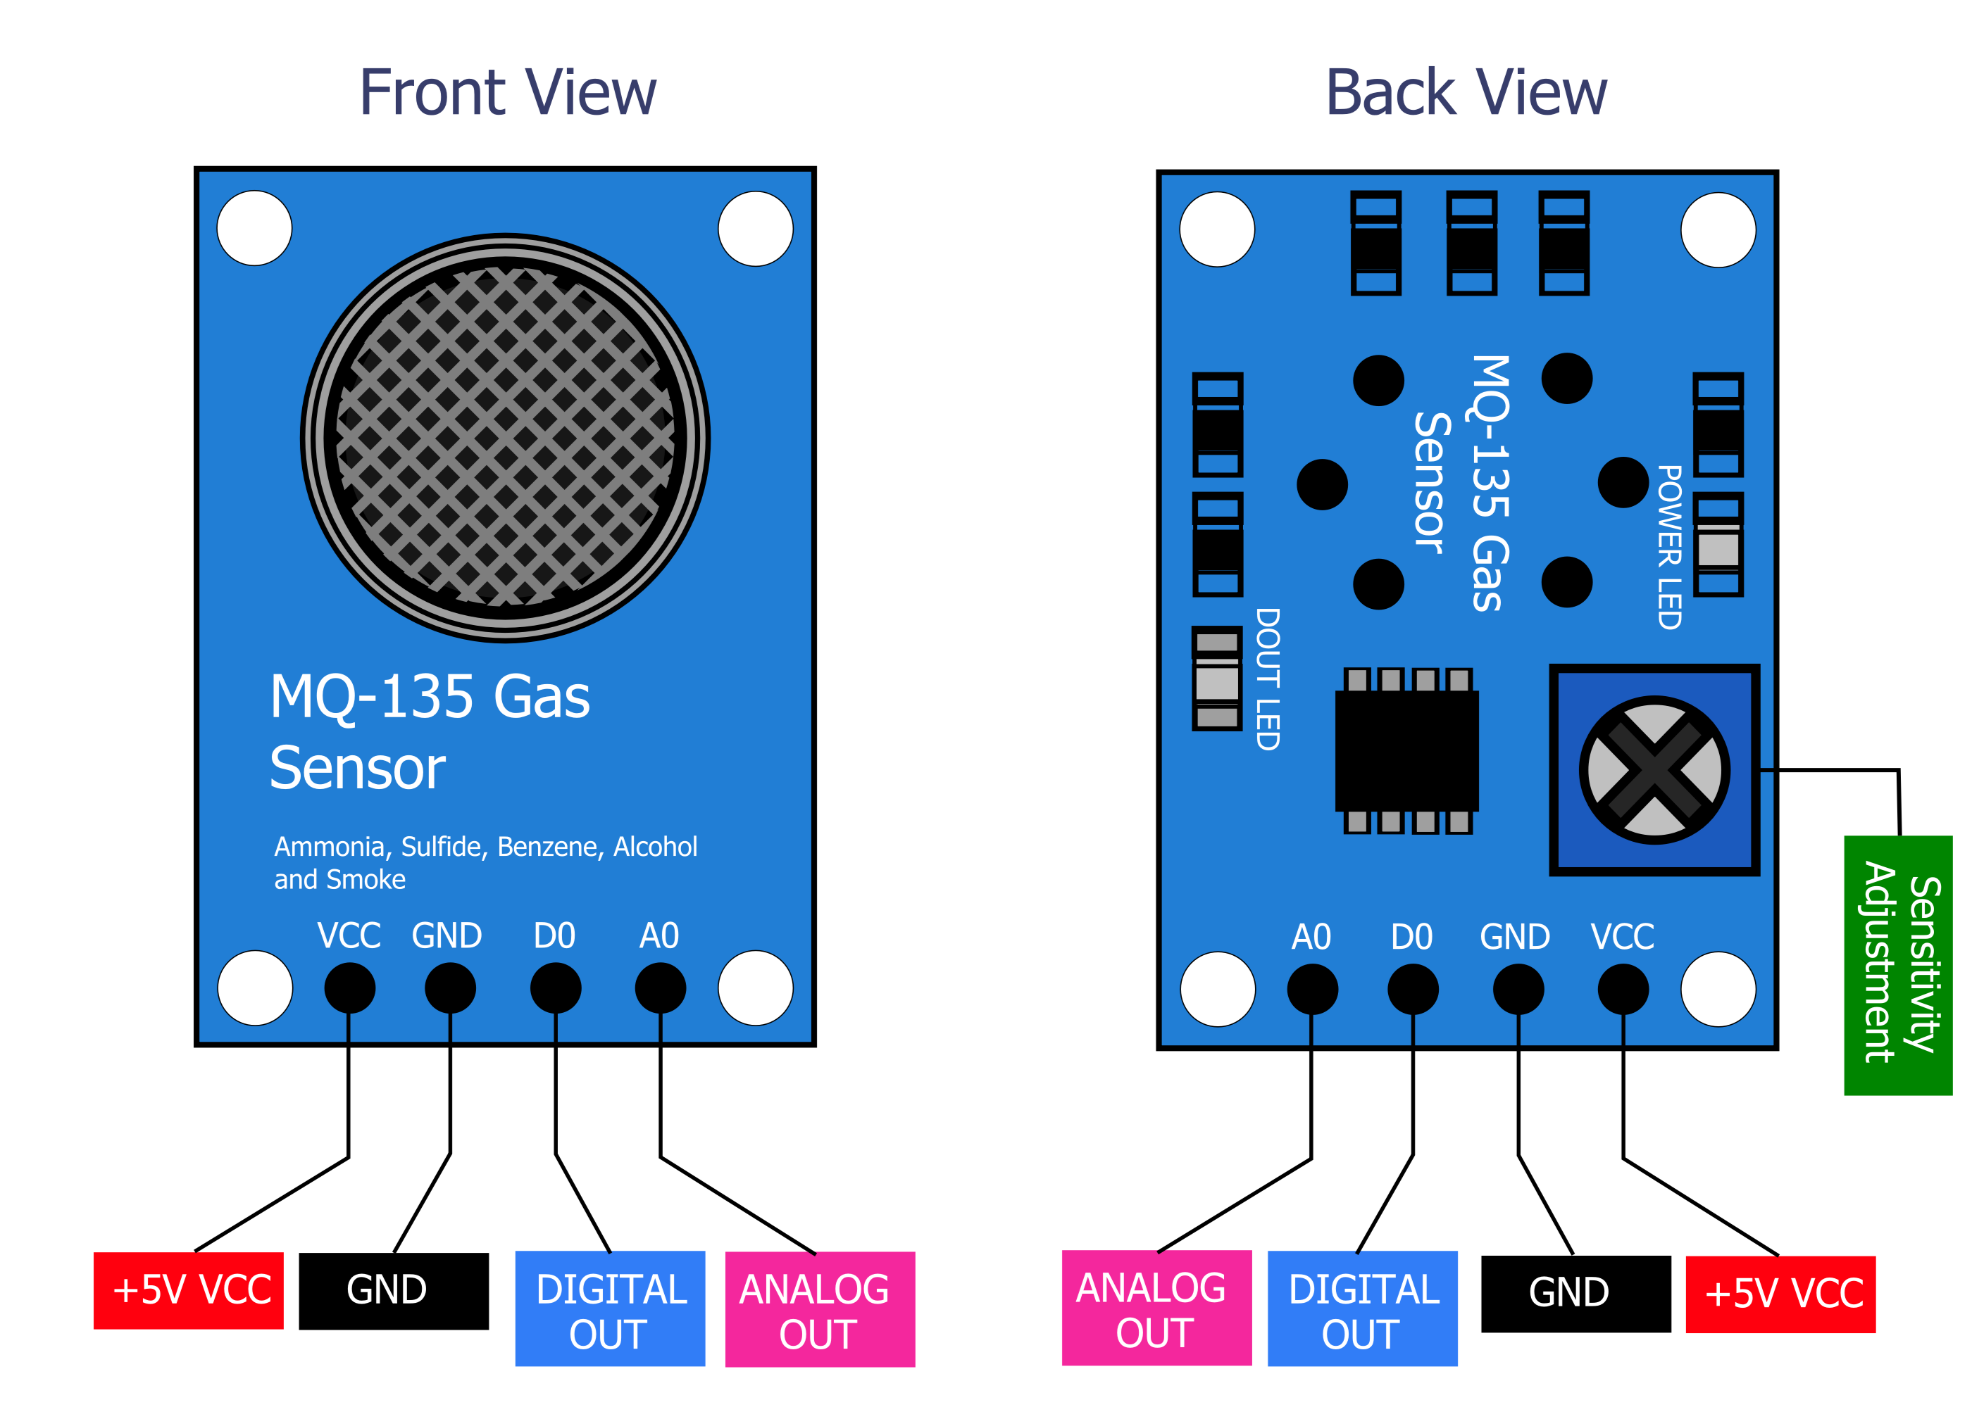
MQ-135 Gas Sensor
The MQ-135 is a gas sensor that is commonly used to detect a variety of gases, especially in applications related to air quality monitoring and safety. It is part of a series of gas sensors produced by the company Winsen. The MQ-135 sensor is particularly known for its ability to detect gases such as:
Ammonia (NH3):
Carbon Dioxide (CO2):
Benzene, Alcohol, and Volatile Organic Compounds(VOCs)
Smoke and Combustible Gases

Slide 4
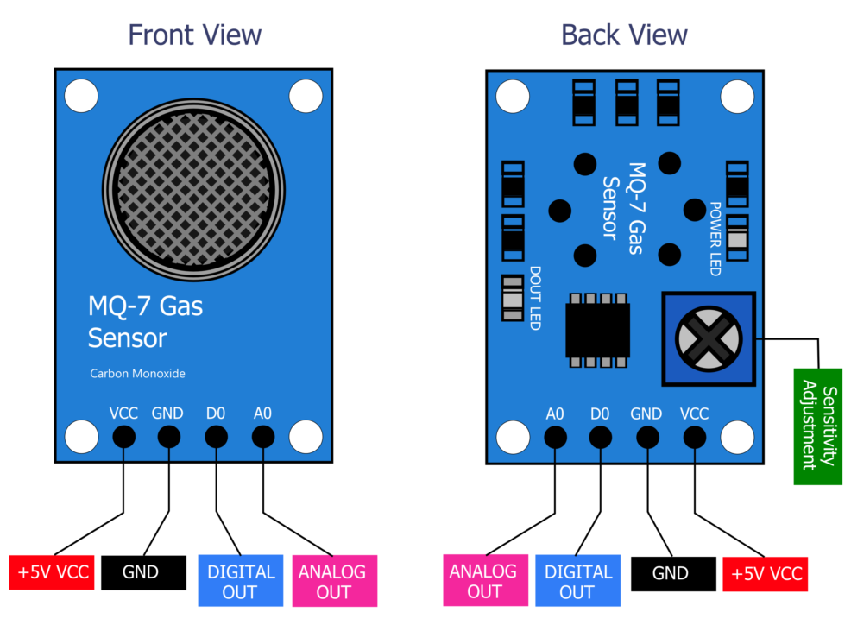
MQ-7 Gas Sensor
The MQ-7 is a gas sensor commonly used for the detection of carbon monoxide (CO) and natural gas (methane, CH4) in the air. It is part of the MQ series of gas sensors produced by the company Winsen and is widely used in applications related to safety and environmental monitoring.

Slide 5
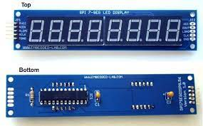
LED Screen Display
LED displays are known for their high brightness, energy efficiency, and versatility, making them popular in a wide range of applications, from consumer electronics to large-scale digital billboards.

Slide 6

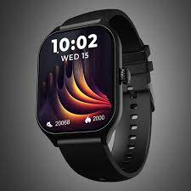

System
In here system is a communicating device that interconnect with the devices to monitor and analyze the data continuously under a human vision.
We can monitor directly by the user by some methods like:
Mobile
Smart watch
Computer system

